Slide 1
Environmental Impact Assessment (EIA)
Module -3

Slide 2
Contents
Purpose
Steps
Hierarchy of EIA
Environmental Impact Statement and Impact Indicators
Evolution of IA in India and worldwide.
Preliminary stages of EIA
Impact
Prediction
Evaluation and Mitigation.

Slide 3
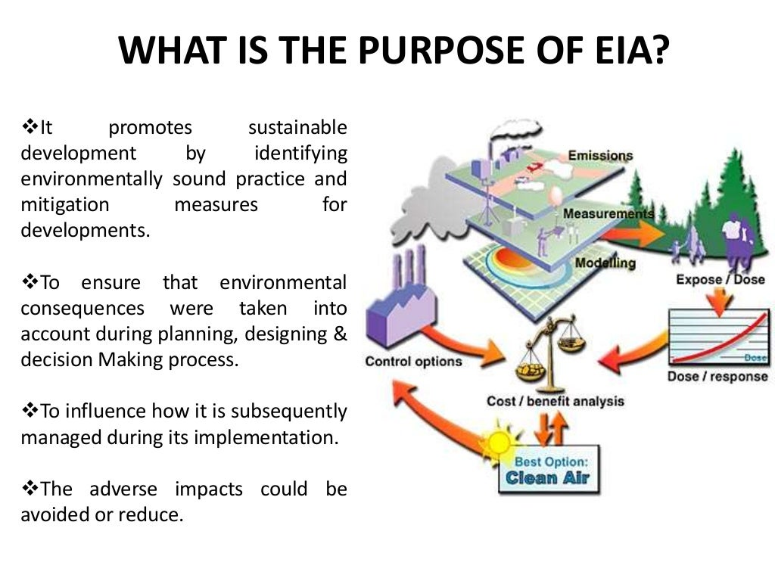
Purpose
Identifies, predicts, evaluates, and mitigates the effects of development proposals before decisions are made.
Analyzes and understands the potential environmental effects of upcoming projects or activities
Is required for major building or development projects in the EU before they can start.
Ensures optimal use of natural resources for sustainable development.
What is EIA and why is India's new EIA draft problematic?
Bing Videos

Slide 4
Steps in EIA
We will explore the Environmental Impact Assessment Process (EIA) and why it matters.
What Is the Environmental Impact Assessment Process?
Environmental Impact Assessment (EIA) is a systematic process in civil engineering to evaluate the potential environmental effects of proposed projects, plans, or developments.
The primary purpose of EIA is to ensure that any undertaking that may impact the environment is thoroughly assessed before implementation.
This process aims to identify, predict, and mitigate the adverse environmental effects while highlighting potential positive impacts.

Slide 5
The key elements of EIA
Identification of impacts – EIA helps identify all the possible environmental effects of a project. This includes direct and indirect impacts as well as cumulative and secondary effects that might not be immediately apparent.
Prediction and assessment – It involves estimating the significance and magnitude of these impacts, allowing for an understanding of their potential consequences.
Mitigation – EIA recommends measures to reduce or eliminate negative environmental impacts. This often leads to the improvement of project designs and the incorporation of sustainable practices.
Public engagement – Public participation is integral to the EIA process. It allows stakeholders, including local communities and environmental groups, to express their concerns and opinions.
Decision support – EIA results serve as a foundation for informed decision-making. Regulatory authorities, project developers, and stakeholders rely on EIA findings to make choices that balance development and environmental conservation.

Slide 6
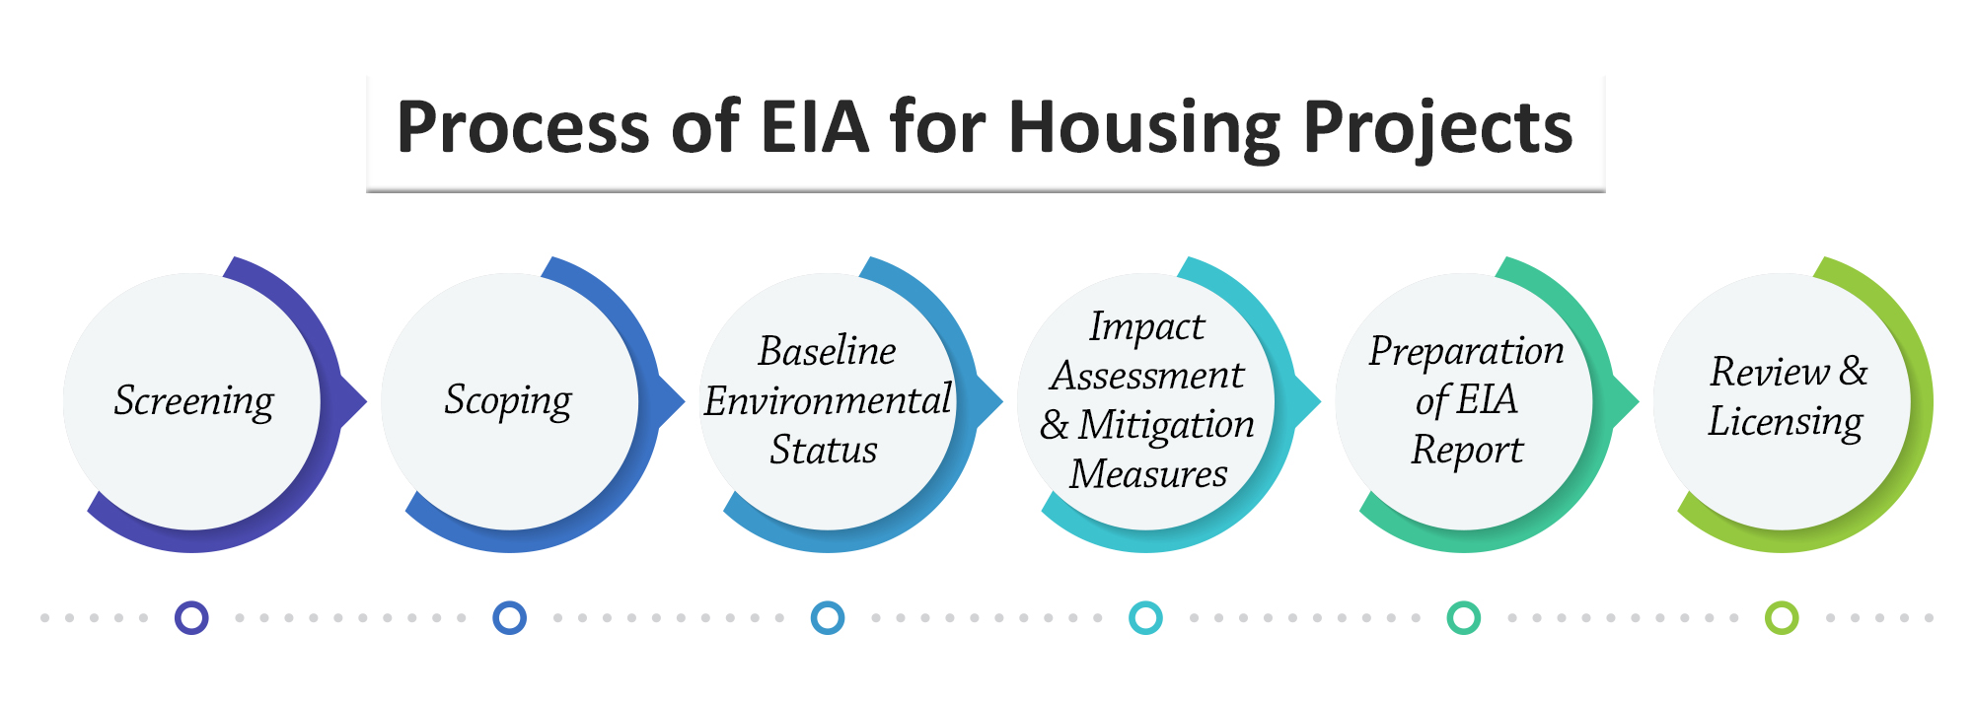
Key Steps in the EIA Process
Screening: Determine if a project requires an EIA and the level of assessment.
Scoping: Define the scope of the assessment.
Baseline Study: Collect data on existing environmental conditions.
Impact Analysis: Assess potential impacts.
Impact Mitigation: Develop measures to minimize adverse effects.
EIA Report: Compile findings and recommendations.
Review of Draft EIA Report: Seek feedback and make revisions.
Decision-making: Authorities review the report and make decisions.

Slide 7

Step-1: Screening
The first step in the EIA process is screening.
During this phase, the regulatory authorities, often in consultation with the project proponent, determine whether a project requires a full EIA.
This screening filters out projects with minimal environmental impact. It also ensures EIA resources serve projects needing in-depth evaluation.

Slide 8
Step-2: Scoping
Step 3- Impact assessment
Scoping is a critical step that follows screening.
It involves defining the boundaries of the EIA study.
During this phase, the project’s scope is clearly defined, and the environmental components to be assessed are identified.
Additionally, scoping provides a framework for the comprehensive evaluation of potential impacts.
It ensures that no important aspect is overlooked.
The heart of the EIA process lies in impact assessment.
In this stage, our civil engineers and environmental experts conduct a detailed evaluation of the project’s potential environmental effects.
This assessment predicts, quantifies, and describes expected impacts on environmental components like air, water, ecosystems, and human health.
So, robust methodologies and data collection provide scientifically sound conclusions.

Slide 9
Step 4- Mitigation and Monitoring
Once the impacts have been assessed, the focus shifts to mitigation and monitoring. Mitigation measures are designed to prevent, reduce, or offset adverse environmental impacts.
These measures often lead to project design, engineering, or operational adjustments to minimize environmental harm.
Simultaneously, monitoring protocols are established to track and verify that the mitigation measures are effective.
These measures ensure that the project complies with environmental regulations and permits.

Slide 10
Step-5 Reporting and decision-making
The final step in the EIA process involves preparing a comprehensive report that summarizes all the findings and steps undertaken during the assessment.
This report is presented to regulatory authorities and other relevant decision-making bodies.
Based on the report’s recommendations and findings, a decision is made regarding whether the project should proceed, be modified, or be rejected entirely.
This stage underscores the significance of the EIA process in guiding environmentally responsible decisions.
ENVIRONMENTAL IMPACT ASSESSMENT REPORT FOR PROPOSED CONSTRUCTION OF 20 PIERS OF APPROACH ROAD AND METRO SPUR LINE TO MOGHARPADA CAR DEPOT AND CASTING YARD AT KAVESAR FOR METRO LINE – 4 PROJECT
4.pdf
PARIVESH

Slide 11
Role of Engineers in EIA
Engineers play an important role in the Environmental Impact Assessment (EIA) process.
It contributes technical expertise to ensure that development projects are feasible and environmentally responsible.
Civil engineers in EIA teams:
The role of civil engineers extends beyond traditional engineering tasks. They are often key members of EIA teams — they assess the project’s potential impacts on infrastructure, such as roads, bridges, and utilities.
They evaluate the engineering aspects of the project, ensuring that it aligns with environmental regulations and standards. Civil engineers collaborate with environmental scientists, geologists, and other professionals to comprehensively assess the environmental implications of a project.
So, their technical insights are crucial in shaping the mitigation strategies and project modifications that minimize adverse impacts.

Slide 12

Utilizing Engineering Expertise
Civil engineering students and enthusiasts venturing into EIA should recognize that their engineering expertise is valuable in crafting sustainable solutions.
Their analytical and problem-solving skills are essential for identifying mitigation measures that are both environmentally and technically feasible.
Through environmental impact assessments, engineers can contribute to developing projects that harmonize development goals with ecological preservation.
It can positively impact the environment.

Slide 13
Hierarchy of EIA
The hierarchy of Environmental Impact Assessment (EIA) in India follows a structured process under the Environmental Protection Act, 1986, regulated by the Ministry of Environment, Forest and Climate Change (MoEFCC). The key components of the hierarchy are:
1. Regulatory Authorities
Ministry of Environment, Forest and Climate Change (MoEFCC) – Central authority for EIA at the national level.
Expert Appraisal Committees (EACs) – Sector-specific committees at the central level that review and recommend projects for environmental clearance.
State Environment Impact Assessment Authorities (SEIAAs) – State-level authorities handling projects under Category ‘B’ as per EIA Notification, 2006.
State Expert Appraisal Committees (SEACs) – Advisory committees assisting SEIAAs in reviewing project proposals.

Slide 14
Example: Hierarchy of Environmental Impact Assessment (EIA) for a Hydroelectric Power Project
Let’s consider a 500 MW hydroelectric power project planned on a river. The EIA process follows a clear hierarchical structure involving different authorities and stages.
Hierarchy of EIA for a Hydroelectric Power Project
1. Regulatory Authorities (Decision-Making Bodies)
A. Central Level (For Large Projects)
Ministry of Environment, Forest and Climate Change (MoEFCC) – Approves EIA reports for Category A projects (hydroelectric projects >25 MW).
Expert Appraisal Committee (EAC) – Reviews and evaluates the EIA report for hydroelectric projects before MoEFCC approval.
B. State Level (For Smaller Projects)
State Environment Impact Assessment Authority (SEIAA) – Approves Category B projects (hydroelectric projects ≤25 MW).
State Expert Appraisal Committee (SEAC) – Assists SEIAA in reviewing projects at the state level.

Slide 15
Example: Hierarchy of Environmental Impact Assessment (EIA) for a Hydroelectric Power Project
2. Categorization of the Project
Since the hydroelectric project is 500 MW, it falls under Category A (Large Projects).
The EAC at the Central level (MoEFCC) is responsible for reviewing the EIA.
3. EIA Process and Stages:
A. Screening
Since the project is above 25 MW, it does not qualify for an exemption and requires a full EIA study.
The project proponent (company or government agency) must submit a request for environmental clearance.

Slide 16
Example: Hierarchy of Environmental Impact Assessment (EIA) for a Hydroelectric Power Project
B. Scoping
The EAC at the central level reviews the Terms of Reference (ToR) and identifies key environmental issues:
Impact on river ecosystems and fish populations
Deforestation due to dam construction
Displacement of local communities
Changes in sediment flow affecting downstream areas
C. EIA Report Preparation
Environmental consultants conduct a detailed study on water quality, biodiversity, geological impact, and social impact.
A Draft EIA Report is submitted, including an Environmental Management Plan (EMP) to reduce negative impacts (e.g., fish ladders to allow fish movement).
D. Public Consultation
A public hearing is conducted in the affected areas, allowing local residents, tribal communities, and NGOs to voice concerns.
If major concerns arise (e.g., displacement of indigenous communities), the EIA report must address them before final submission.

Slide 17
Example: Hierarchy of Environmental Impact Assessment (EIA) for a Hydroelectric Power Project
E. Appraisal
The EAC at the Central level reviews the EIA report, public feedback, and mitigation measures.
If satisfactory, the MoEFCC grants Environmental Clearance with specific conditions.
F. Post-Clearance Monitoring
The project must comply with water quality standards, afforestation commitments, and wildlife protection measures.
The State Pollution Control Board (SPCB) monitors compliance, and non-compliance may lead to penalties or project suspension.

Slide 18
Example: Hierarchy of Environmental Impact Assessment (EIA) for a Hydroelectric Power Project
Conclusion: Hierarchical Decision-Making in EIA
MoEFCC (Central) → Reviews & grants final clearance.
EAC (Central) → Examines the report & recommends approval/rejection.
State SEIAA/SEAC → Involved only for smaller projects (≤25 MW).
SPCB → Ensures compliance post-clearance.
This structured hierarchy ensures that large projects undergo strict environmental scrutiny, protecting ecosystems while supporting development.

Slide 19
Environmental Impact Statement (EIS) and Impact Indicators
1. Environmental Impact Statement (EIS)
An Environmental Impact Statement (EIS) is a comprehensive document prepared during the Environmental Impact Assessment (EIA) process. It presents the findings of environmental studies conducted for a proposed project and assesses its potential environmental, social, and economic impacts.
Key Components of an EIS
Project Description – Details about the project, including location, objectives, size, and operations.
Baseline Environmental Conditions – Assessment of the current environmental status before project implementation.
Impact Prediction & Assessment – Identification of potential environmental, social, and economic impacts.
Mitigation Measures – Strategies to reduce, control, or compensate for adverse environmental effects.
Environmental Management Plan (EMP) – Framework for implementing mitigation measures and monitoring impacts.
Public Consultation & Stakeholder Engagement – Summary of concerns raised by affected communities and stakeholders.
Alternative Analysis – Comparison of project alternatives and justification for the chosen option.

Slide 20
Environmental Impact Statement (EIS) and Impact Indicators
Purpose of an EIS
Provides a scientific basis for decision-making by regulatory authorities.
Ensures transparency and public participation in the environmental approval process.
Helps in preventing or minimizing environmental damage before project implementation.

Slide 21
2. Environmental Impact Indicators
Environmental Impact Indicators are measurable factors used to assess and monitor the impact of a project on the environment. These indicators help in understanding the scale, intensity, and significance of environmental changes.
Types of Environmental Impact Indicators
A. Physical Indicators (Assess Natural Resource Changes)
Air Quality Indicators – Concentration of pollutants (e.g., PM2.5, NOx, SO2).
Water Quality Indicators – pH, dissolved oxygen (DO), biochemical oxygen demand (BOD).
Soil Quality Indicators – Erosion rate, heavy metal concentration.
Noise Levels – Measured in decibels (dB) for human and wildlife impact.
B. Biological Indicators (Assess Impact on Flora & Fauna)
Biodiversity Index – Change in species richness and abundance.
Habitat Loss – Percentage of land deforested or converted.
Aquatic Life Health – Changes in fish population and diversity

Slide 22
2. Environmental Impact Indicators
C. Socio-Economic Indicators (Assess Impact on Communities)
Population Displacement – Number of people relocated due to the project.
Livelihood Impact – Change in employment and income levels.
Public Health Indicators – Increase in respiratory diseases due to pollution.
D. Climate Change Indicators
Greenhouse Gas (GHG) Emissions – CO2, methane levels due to project activities.
Carbon Sequestration Rate – Loss or gain in forest cover affecting carbon storage.

Slide 23
Example: EIS & Impact Indicators for a Hydroelectric Dam Project
Environmental Impact Statement (EIS) Summary:
Project: 500 MW Hydroelectric Dam on River X
Identified Impacts:
Deforestation (loss of 500 hectares of forest)
Displacement (relocation of 1,000 families)
Water Flow Reduction (downstream river ecology affected)
GHG Emissions (methane release from submerged vegetation)
Mitigation Measures:
Afforestation program
Rehabilitation plan for displaced communities
Fish ladders to aid aquatic life movement

Slide 24
Example: EIS & Impact Indicators for a Hydroelectric Dam Project
Environmental Impact Indicators Used:
Water Quality → Reduction in dissolved oxygen (DO) levels downstream
Biodiversity Index → Decline in fish species by 20%
Socio-Economic → Increase in alternative livelihood programs (e.g., tourism, fisheries)
Climate Change → Estimated carbon loss due to deforestation
This structured approach ensures that environmental impacts are identified, mitigated, and monitored effectively.

Slide 25
Evolution of Impact Assessment (IA) in India and Worldwide
1. Evolution of Impact Assessment Worldwide
Impact Assessment (IA) has evolved as a key environmental management tool globally, starting with Environmental Impact Assessment (EIA) and later expanding to include Social Impact Assessment (SIA), Strategic Environmental Assessment (SEA), and Cumulative Impact Assessment (CIA).
A. Key Milestones in Global Impact Assessment
National Environmental Policy Act (NEPA), 1969 – USA
The USA became the first country to introduce Environmental Impact Assessment (EIA) under NEPA.
Required federal agencies to assess environmental consequences before approving projects.
Stockholm Conference, 1972 – Global Recognition
First United Nations Conference on Human Environment emphasized environmental protection.
Led to the formation of the United Nations Environment Programme (UNEP).
Environmental Impact Assessment (EIA) Directive, 1985 – European Union
Made EIA mandatory for large-scale projects in European Union (EU) countries.
Rio Earth Summit, 1992 – Sustainable Development
Introduced Agenda 21, promoting EIA as a global standard for development projects.
Led to Strategic Environmental Assessment (SEA) for policy and program-level assessments.
Convention on Biological Diversity (CBD), 1992
Encouraged nations to integrate biodiversity concerns into EIA and SEA.
Paris Agreement, 2015 – Climate Impact Assessment
Highlighted the importance of Climate Change Impact Assessments in development planning.

Slide 26
Preliminary Stages of Environmental Impact Assessment (EIA)
The Environmental Impact Assessment (EIA) process consists of multiple stages, starting with preliminary assessments before a full study is conducted. These preliminary stages are crucial in determining whether a project requires an EIA and defining the scope of the study.

Slide 27
Preliminary Stages of Environmental Impact Assessment (EIA)
1. Screening
Purpose: Determines whether a project needs an EIA and, if required, its level of assessment.
Key Activities:
Categorization of the project (as per regulatory frameworks like India's EIA Notification, 2006).
Projects are classified into:
Category A – Requires a full EIA and clearance from MoEFCC (e.g., large thermal power plants).
Category B – Assessed by SEIAA at the state level and further divided into:
B1 – Requires a full EIA.
B2 – Exempted from detailed EIA but needs environmental management measures.
Small-scale projects with negligible impacts may be exempted from EIA.
Example: A 500 MW coal-based power plant is classified as Category A and requires a full EIA, while a small textile unit may fall under B2, needing only basic environmental management measures.

Slide 28
Preliminary Stages of Environmental Impact Assessment (EIA)
2. Scoping
Purpose: Defines the key environmental issues, impact areas, and study requirements.
Key Activities:
Development of Terms of Reference (ToR) outlining:
Potential environmental impacts (air, water, biodiversity, land use, communities).
Required data collection (baseline studies, pollution levels, biodiversity surveys).
Alternative project sites or technologies to minimize impact.
Conducted by project proponents with guidance from the Expert Appraisal Committee (EAC) or State Expert Appraisal Committee (SEAC).
Example: A hydroelectric dam project may have scoping focused on:
Biodiversity impact (fish migration disruption).
Displacement of local communities (rehabilitation requirements).
Downstream water flow changes (impact on agriculture and drinking water).

Slide 29
Preliminary Stages of Environmental Impact Assessment (EIA)
3. Baseline Data Collection
Purpose: Establishes existing environmental conditions before the project begins.
Key Activities:
Collection of scientific data on:
Air Quality – PM2.5, NOx, SOx levels.
Water Quality – pH, dissolved oxygen, contamination levels.
Soil and Land Use – Erosion, fertility, land cover changes.
Biodiversity – Species diversity, endangered species, ecosystem health.
Social & Economic Conditions – Population demographics, livelihood dependency.
Carried out through field surveys, remote sensing, and historical data analysis.
Example: If an oil refinery is planned near a mangrove forest, baseline data would include:
Existing air and water quality in the area.
Mangrove ecosystem health and potential biodiversity loss.
Fisheries dependence of local communities.

Slide 30
Preliminary Stages of Environmental Impact Assessment (EIA)
3. Baseline Data Collection
Purpose: Establishes existing environmental conditions before the project begins.
Key Activities:
Collection of scientific data on:
Air Quality – PM2.5, NOx, SOx levels.
Water Quality – pH, dissolved oxygen, contamination levels.
Soil and Land Use – Erosion, fertility, land cover changes.
Biodiversity – Species diversity, endangered species, ecosystem health.
Social & Economic Conditions – Population demographics, livelihood dependency.
Carried out through field surveys, remote sensing, and historical data analysis.
Example: If an oil refinery is planned near a mangrove forest, baseline data would include:
Existing air and water quality in the area.
Mangrove ecosystem health and potential biodiversity loss.
Fisheries dependence of local communities.

Slide 31
Preliminary Stages of Environmental Impact Assessment (EIA)
4. Impact Identification & Prediction
Purpose: Identifies potential environmental and social impacts of the project.
Key Activities:
Direct Impacts – Air pollution, deforestation, land degradation.
Indirect Impacts – Groundwater depletion, secondary job creation.
Cumulative Impacts – Multiple projects in the same region affecting resources.
Use of mathematical models, Geographic Information Systems (GIS), and past case studies for accurate predictions.
Example: For a mining project, impacts identified might include:
Deforestation and soil erosion affecting nearby villages.
Heavy metal contamination of water sources.
Increased employment in the region.

Slide 32
Preliminary Stages of Environmental Impact Assessment (EIA)
Conclusion
The preliminary stages of EIA (Screening, Scoping, Baseline Data Collection, and Impact Identification) are critical in ensuring that environmental assessments focus on the most relevant and significant impacts. These steps guide decision-makers in approving, modifying, or rejecting projects based on their environmental feasibility.

Slide 33
Impact of Environmental Impact Assessment (EIA)
Environmental Impact Assessment (EIA) has played a critical role in balancing development with environmental protection. Its impact can be analyzed in environmental, social, economic, legal, and governance aspects.

Slide 34
Impact of Environmental Impact Assessment (EIA)
1. Environmental Impact
✅ Prevention of Environmental Degradation
EIA ensures that projects do not cause irreversible damage to air, water, and biodiversity.
Example: Hydroelectric Projects now include fish ladders to prevent aquatic biodiversity loss.
✅ Promotion of Sustainable Resource Use
Encourages industries to adopt eco-friendly technologies and waste management systems.
Example: Thermal power plants are mandated to install flue gas desulfurization (FGD) units to reduce SO₂ emissions.
✅ Conservation of Natural Habitats
Identifies ecologically sensitive zones where development should be restricted.
Example: The Western Ghats, a biodiversity hotspot, has strict EIA regulations to prevent deforestation.

Slide 35
Impact of Environmental Impact Assessment (EIA)
2. Social Impact
✅ Protection of Local Communities & Indigenous Rights
EIA ensures that large infrastructure projects do not displace people unfairly.
Social Impact Assessments (SIA) are conducted to evaluate how projects affect livelihoods, health, and cultural heritage.
Example: Tribal displacement due to mining projects in Jharkhand has led to rehabilitation and compensation measures.
✅ Improved Public Participation
EIA mandates public hearings where affected communities can voice concerns.
Example: Sterlite Copper Plant, Tamil Nadu was shut down due to strong public opposition citing environmental concerns.
✅ Better Health & Safety Standards
Industrial projects must follow occupational safety and pollution control norms to prevent health hazards.
Example: Bhopal Gas Tragedy (1984) led to stricter environmental and industrial safety laws.

Slide 36
Impact of Environmental Impact Assessment (EIA)
3. Economic Impact
✅ Cost Savings through Risk Prevention
EIA helps companies avoid legal disputes and environmental fines by identifying risks early.
Example: Companies investing in green technologies often receive government incentives.
✅ Encourages Green Investments
Many businesses now focus on renewable energy projects, waste recycling, and carbon credits due to EIA regulations.
Example: Growth of solar and wind power projects in India due to environmental clearance ease.
✅ Job Creation & Economic Growth
Environmental management projects create jobs in green energy, waste management, and sustainable infrastructure.

Slide 37
Impact of Environmental Impact Assessment (EIA)
4. Legal & Governance Impact
✅ Stronger Environmental Laws & Compliance
EIA has led to the formulation of laws like the Environment Protection Act, 1986, ensuring stricter regulations.
✅ Monitoring & Enforcement by Regulatory Bodies
National Green Tribunal (NGT) enforces compliance and takes action against violations.
Example: Closure of polluting industries near the Ganga River under Namami Gange Programme.
✅ Climate Change Mitigation
Climate Impact Assessments are now integrated into EIAs to reduce greenhouse gas emissions.
Example: Paris Agreement (2015) has influenced India’s Net Zero Emissions target for 2070.

Slide 38
Prediction in Environmental Impact Assessment (EIA)
What is Prediction in EIA?
Prediction in Environmental Impact Assessment (EIA) refers to the process of forecasting the potential environmental, social, and economic impacts of a proposed project before it is implemented. This helps decision-makers anticipate risks, develop mitigation measures, and ensure sustainable development.

Slide 39
1. Types of Predictions in EIA
A. Environmental Predictions
✅ Air Quality Prediction – Uses dispersion models to estimate how pollutants (e.g., PM2.5, SO₂, NOx) will spread. ✅ Water Quality Prediction – Forecasts pollution levels in rivers, lakes, or groundwater due to industrial discharge. ✅ Soil & Land Degradation Prediction – Assesses risks like soil erosion, deforestation, and loss of agricultural productivity. ✅ Biodiversity Impact Prediction – Estimates habitat destruction, species displacement, or loss of ecological balance.

Slide 40
1. Types of Predictions in EIA
B. Social & Economic Predictions
✅ Population Displacement Prediction – Identifies how many people will be affected by land acquisition or resettlement. ✅ Health Impact Prediction – Assesses the risk of diseases due to air pollution, water contamination, or industrial waste. ✅ Economic Impact Prediction – Forecasts employment generation, GDP contribution, and livelihood changes.
C. Climate Change Predictions
✅ Carbon Footprint Estimation – Predicts the amount of CO₂ and other greenhouse gases (GHGs) emitted. ✅ Temperature & Rainfall Pattern Changes – Uses climate models to estimate the impact on local and regional weather conditions.

Slide 41
2. Methods Used for Prediction
📌 Mathematical & Statistical Models – Examples:
AERMOD (Air Quality Prediction)
WEAP (Water Quality & Availability Forecasting)
GIS & Remote Sensing (Land Use & Deforestation Monitoring)
📌 Baseline Data Comparison – Comparing past environmental conditions with expected project changes.
📌 Expert Opinion & Case Studies – Using experiences from similar projects to predict possible impacts.
📌 Simulation Techniques – Computer-based modeling to simulate future scenarios.

Slide 42
3. Example of EIA Prediction – Coal Power Plant
Project: 1000 MW Coal Power Plant
✅ Air Pollution Prediction – SO₂ emissions expected to increase PM2.5 concentration by 20% within a 10 km radius. ✅ Water Pollution Prediction – Heavy metal contamination in nearby river exceeding safe limits. ✅ Health Impact Prediction – Higher cases of respiratory diseases in nearby communities. ✅ Climate Impact Prediction – Annual carbon emissions of 2 million tons, contributing to global warming.

Slide 43
4. Importance of Prediction in EIA
🔹 Helps in Informed Decision-Making – Avoids environmentally destructive projects. 🔹 Enables Effective Mitigation – Helps plan pollution control, afforestation, and rehabilitation programs. 🔹 Prevents Environmental Disasters – Forecasts risks like flooding, landslides, or water shortages. 🔹 Ensures Compliance with Regulations – Meets environmental standards set by MoEFCC, CPCB, and SEIAA.

Slide 44
Evaluation and Mitigation
Evaluation and Mitigation in Environmental Impact Assessment (EIA)
1. Evaluation in EIA
Evaluation in EIA involves analyzing the predicted environmental, social, and economic impacts of a project to determine its overall acceptability and identify necessary mitigation measures.
2. Mitigation Measures in EIA
Mitigation refers to strategies to reduce, prevent, or compensate for adverse environmental impacts identified during the evaluation stage.

Slide 45
A. Key Aspects of Evaluation
✅ Comparison with Environmental Standards
Ensures compliance with laws such as Air Act (1981), Water Act (1974), and EIA Notification (2006).
Example: Industrial projects must meet CPCB (Central Pollution Control Board) emission standards.
✅ Significance of Impacts
Categorizing impacts as high, moderate, or low based on extent, duration, and reversibility.
Example: Deforestation for a highway project may have high biodiversity loss but low impact on air quality.
✅ Cost-Benefit Analysis
Balances environmental damage with economic and social benefits of the project.
Example: A hydropower dam provides renewable energy but may cause loss of aquatic ecosystems.
✅ Public & Expert Review
Public hearings and expert opinions help refine the evaluation process.
Example: The Sterlite Copper Plant faced closure after public protests over pollution.

Slide 46
A. Types of Mitigation Measures
A.1. Avoidance Measures
Completely avoiding harmful activities or choosing alternative project sites.
Example: A wildlife sanctuary is avoided when planning a highway route.
A.2. Minimization Measures
Reducing the scale or intensity of adverse impacts.
Example: Installing air pollution control devices in power plants to reduce emissions.
A.3. Restoration Measures
Rehabilitating ecosystems affected by development projects.
Example: Afforestation programs after deforestation for a mining project.
A.4. Compensation (Offset) Measures
Providing alternatives or benefits to affected communities and ecosystems.
Example: Providing alternative water sources for communities affected by groundwater depletion.

Slide 47
B. Examples of Mitigation Measures in Different Sectors
Sector | Potential Impact | Mitigation Measure
Mining | Land degradation, deforestation | Reforestation, mine reclamation
Thermal Power | Air & water pollution | Install Flue Gas Desulfurization (FGD)
Hydropower | River ecosystem disruption | Fish ladders, controlled water release
Highway Projects | Wildlife disruption | Eco-bridges, noise barriers
Industrial Projects | Waste disposal issues | Zero Liquid Discharge (ZLD) technology

Slide 48
3. Importance of Evaluation & Mitigation in EIA
✅ Prevents Environmental Degradation – Ensures sustainable development. ✅ Protects Human Health – Reduces air, water, and soil pollution risks. ✅ Ensures Legal Compliance – Meets MoEFCC, CPCB, and SEIAA regulations. ✅ Enhances Project Sustainability – Minimizes long-term environmental costs.
Evaluation and mitigation are critical steps in EIA that help ensure that projects proceed with minimum environmental and social damage. Implementing effective mitigation measures makes development more sustainable and environmentally responsible.

Slide 49
THANK YOU!!

